Slide 1

Online Movie Ticket Booking
GROUP NO : 8

Slide 2
Team Members
Employee Id | Name
2487595 | Samruddhi Bhaskar Randive ( Team Lead)
2485180 | Rohith Molumuri ( Backend-Lead)
2487061 | Vincy Esther A ( Frontend – Lead )
2486561 | Vaddineni Srinadh
2487086 | Sai Nithin G
2487691 | Vundela Pavan Kumar
2487497 | Sandesh Ravindra Thorat
2484021 | Sajja Siva Sai Sri
2484951 | Vadlamudi Ramesh

Slide 3
INDEX
Introduction
Project Scope
Tools & Technologies
ER Diagram
Admin Module
User Module
Output
Conclusion

Slide 4
INTRODUCTION
Movie Ticket Booking System has been developed to override the problems of existing manual system.
Every organization ,whether it is big or small has challenges to overcome and managing the information of customer, movie, payment, shows, seats etc.
This website is supported to eliminate and in some cases reduce the hardships faced by this existing offline system. Moreover this system is designed to carry out the particular operations in a smooth manner.
No formal or prior knowledge is needed for the user to use this system .Thus by this all it provides it is user-friendly.
Movie Ticket Booking System as described above can lead to error free, secure, reliable and fast management system .It can assist the user to concentrate on their other activities rather to concentrate on the record keeping .
Thus it will help organization in better utilization of resources.

Slide 5
PROJECT SCOPE
This project “Online Movie Ticket Booking” makes the task faster and easy. This is used to manage records.
The system is used to keep the record of Login details, Registration details ,Ticket details.

Slide 6




TECHNOLOGIES :
Front end: Angular
Server Side: Spring Boot
Back-end: Hibernate, MY SQL
Server: Tomcat 8.5

Slide 7


PORTAL
ADMIN
USER

Slide 8

Login/Create Account
View/Update/Delete (Movies)
Booking /Customer
(Details after booking tickets)
User
Admin
Book Tickets
Update/ Edit Profile

Slide 9
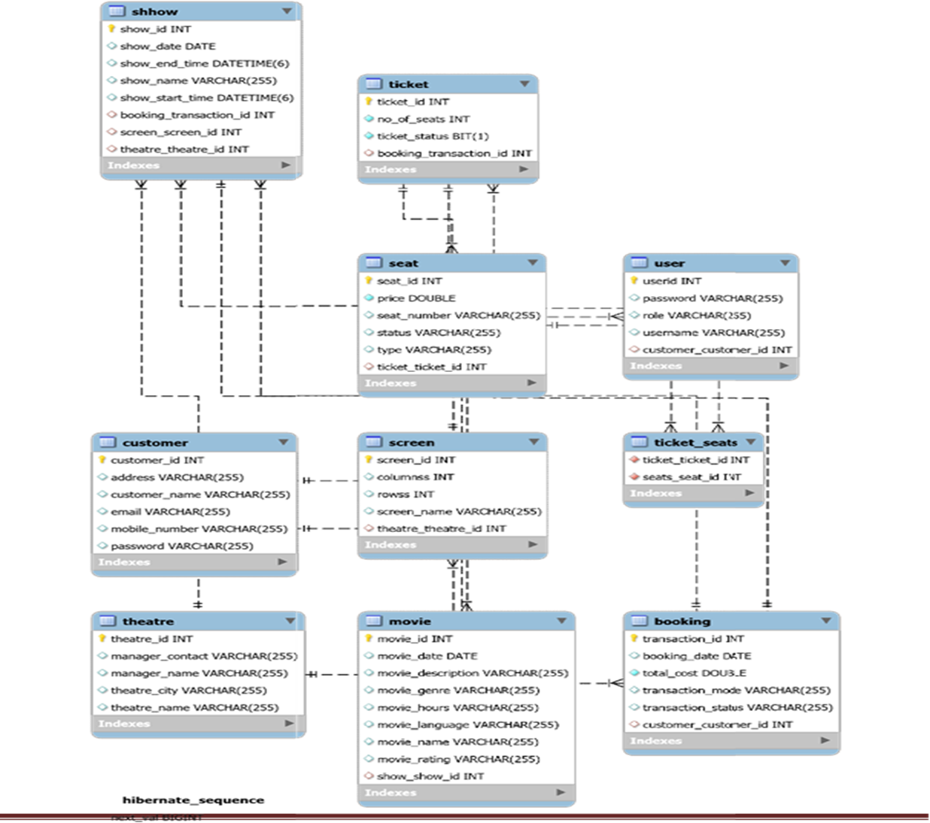
SCHEMA

Slide 10
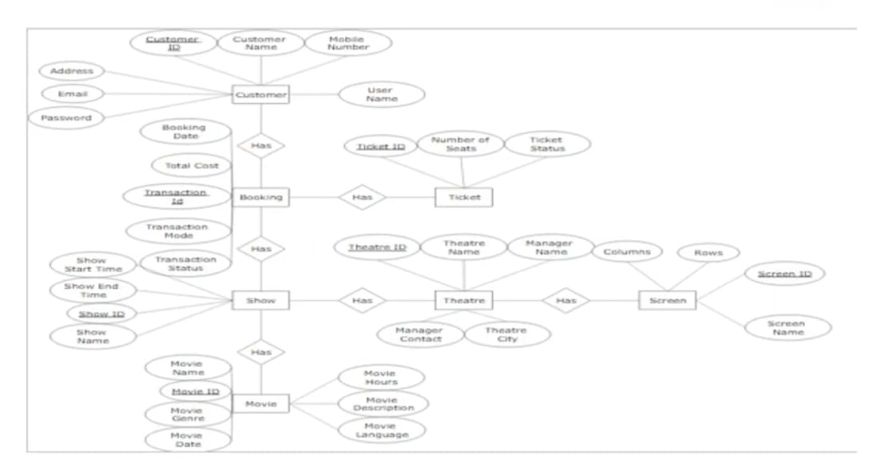
Er Diagram :

Slide 11
ADMIN MODULE
Login to portal
Create Admin Account
Edit movie details like name, ticket price, language, description, and show timings to keep it aligned to the current prices.
Add the movies, Theatre ,Screen ,Show, seats
Delete the Movies
Booking Details
Customer Details
Logout

Slide 12
USER MODULE
Register to the application.
Update Profile.
Sign into the application to maintain the record of activities.
Search for movie tickets based on the search keyword
Book Ticket
Experience a seamless payment process.
Receive a booking summary page once the payment is complete

Slide 13
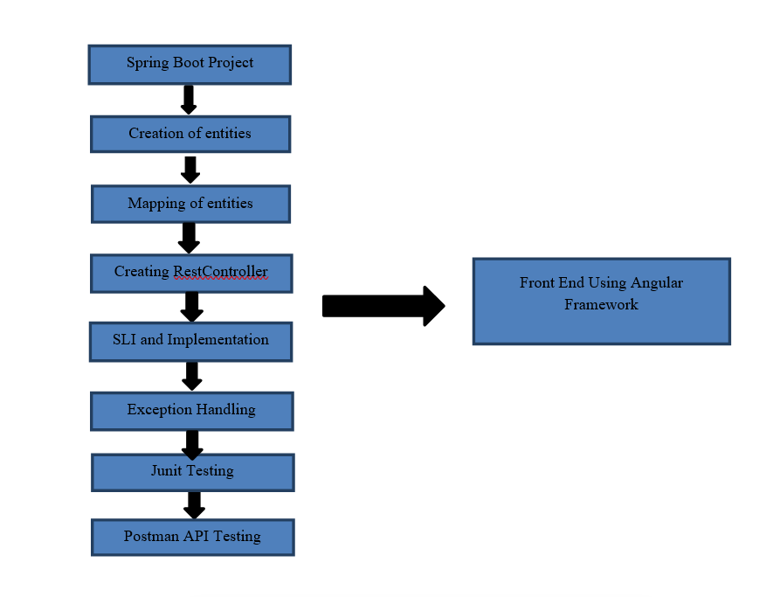
FLOW DIAGRAM :

Slide 14
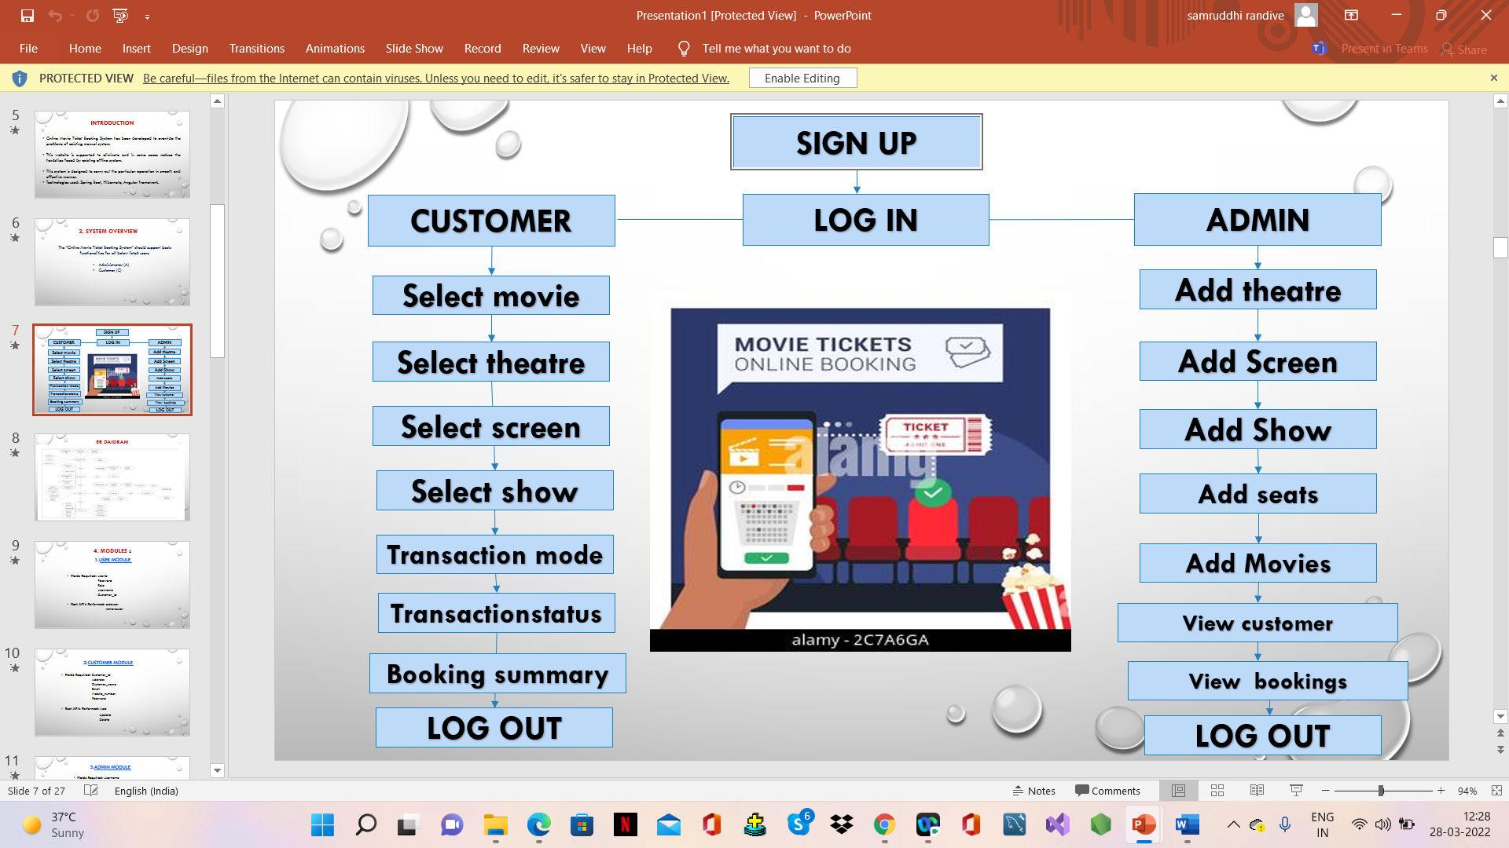

Slide 15
PROPOSED SYSTEM
The online cinema ticket booking system will provide facility to book tickets for a movie online.
A user can book tickets anytime and anywhere as the system will be online based .
The online cinema ticket booking system will provide detailed information so that a customer can know about the movie and based on the information customer will book the ticket.
The user can search for the movies which will be going to release in the future ,so they will have an option to book the ticket in advance.
The online cinema ticket booking system will make the user experience much better than the present system .

Slide 16
1.USER MODULE
Fields Required: Userid
Password
Role
Username
Customer_id
Rest API’s Performed: adduser
removeuser

Slide 17
2.CUSTOMER MODULE
Fields Required: Customer_id
Address
Customer_name
Email
Mobile_number
Password
Rest API’s Performed:
update
Add
Delete

Slide 18
3.ADMIN MODULE
Fields Required: Username
Password
Rest API’s Performed: add

Slide 19
4. LOGIN MODULE
Fields Required: Username
Password
Rest API’s Performed: add
remove

Slide 20
5.MOVIE MODULE
Fields Required: Movie_id
Movie date
Movie description
Movie genre
Movie hours
Movie language
Movie name
Movie rating
Show_show_id
Rest API’s Performed: movie/add
movie/map
movie/findall
movie/rename
viewmovie/movieid

Slide 21
6.THEATRE MODULE
Fields Required: Theatreid
Manager Contact
Manager name
Theatre name
Theatre city
Rest API’s Performed: show/add
show/all
showtheatre/theatreid

Slide 22
7.SCREEN MODULE
Fields Required: Screenid
Columns
Row
Screen name
Theatre_theatre_id
Rest API’s Performed: add
update
view
findall

Slide 23
8.SHOW MODULE
Fields Required: Showid
Show start time
Show end time
Show name
Movie.movie_id
Screen.screen_id
Theatre.theatre_id
Booking.transaction_id
Rest API’s Performed: Add
Delete by id
Update by id
View by id
Find all
show theatre by theatre id

Slide 24
9.SEATS MODULE
Fields Required: Seatid
Seat price
Seat number
Seat status
Seat type
Ticket.ticket_id
Rest API’s Performed: add
findall
update
book
cancel

Slide 25
10.TICKETS MODULE
Fields Required: Ticketid
No.of seats
Ticket status
booking_transaction_id
Rest API’s Performed: add
findall/view
view by ticket id

Slide 26
11.BOOKING MODULE
Fields Required: Transactionid
Booking date
Total cost
Transaction mode
Transaction status
customer.customer_id
Rest API’s Performed: add
delete
view

Slide 27
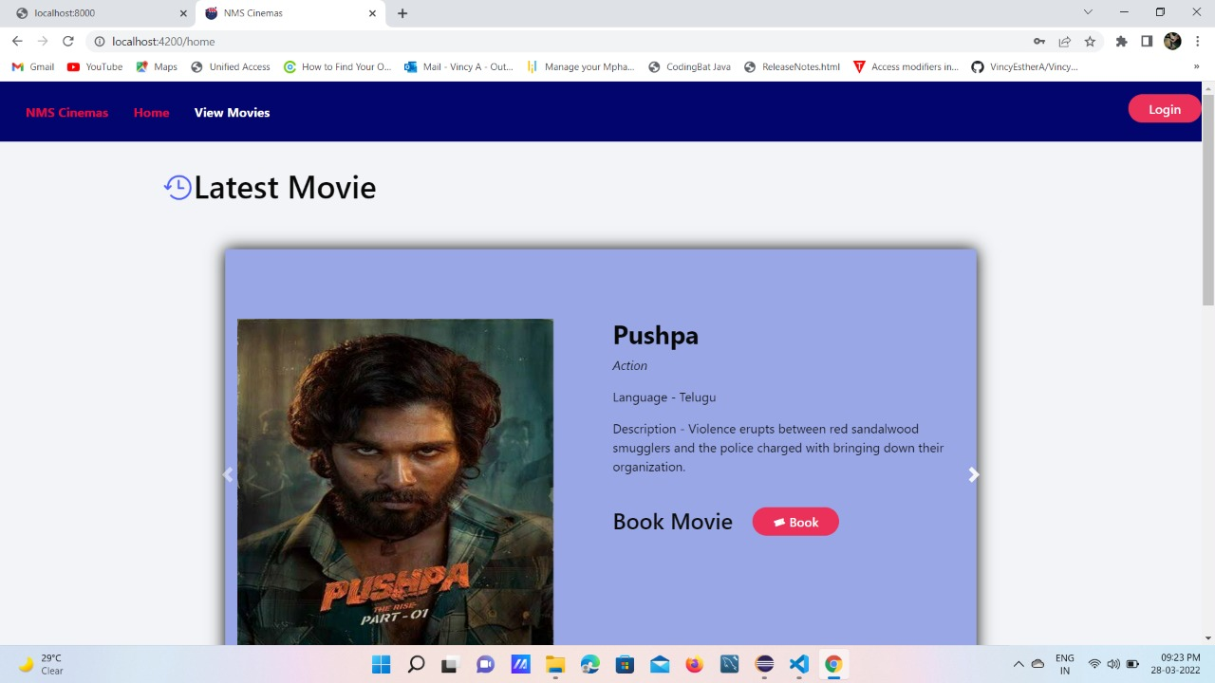

Slide 28
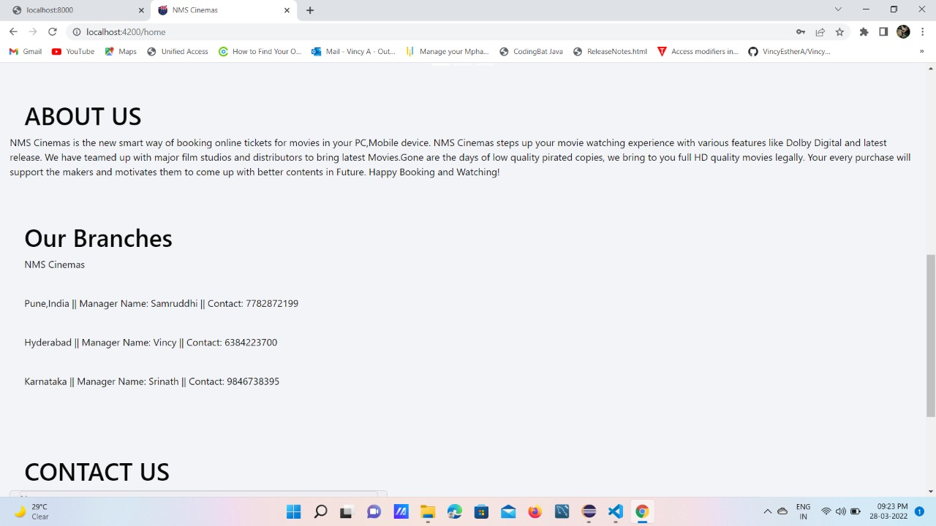

Slide 29
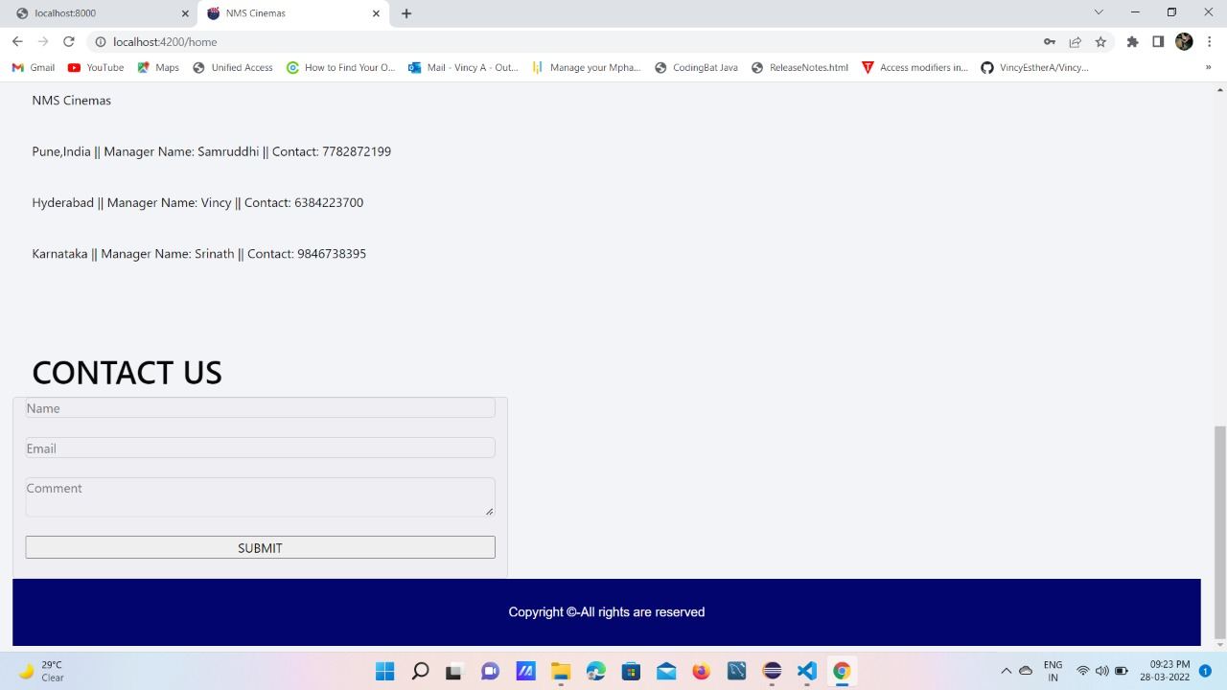

Slide 30
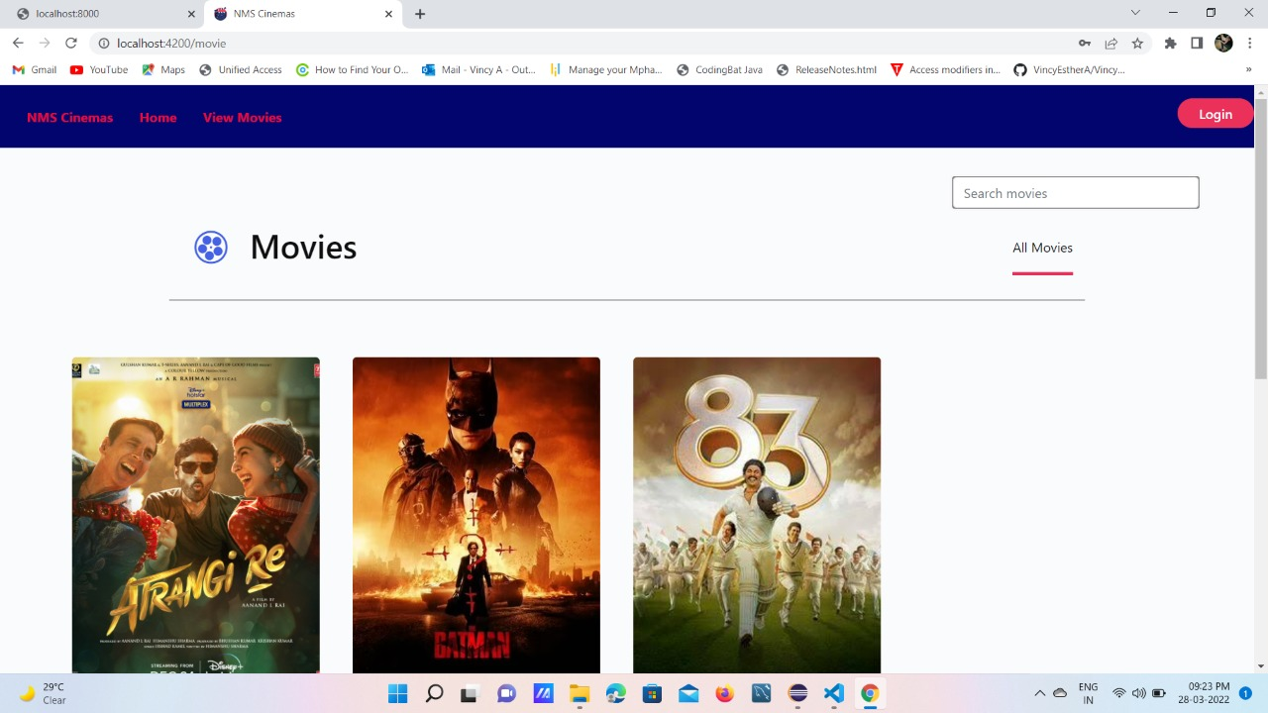

Slide 31
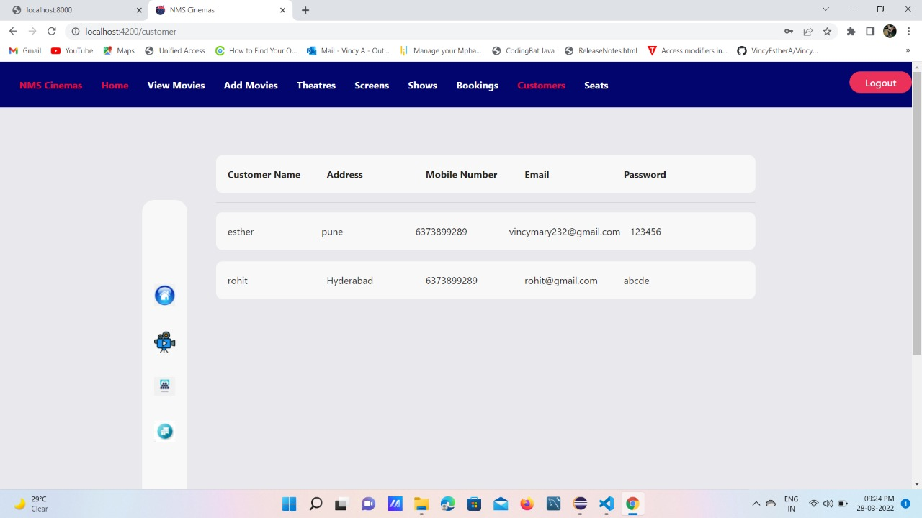

Slide 32
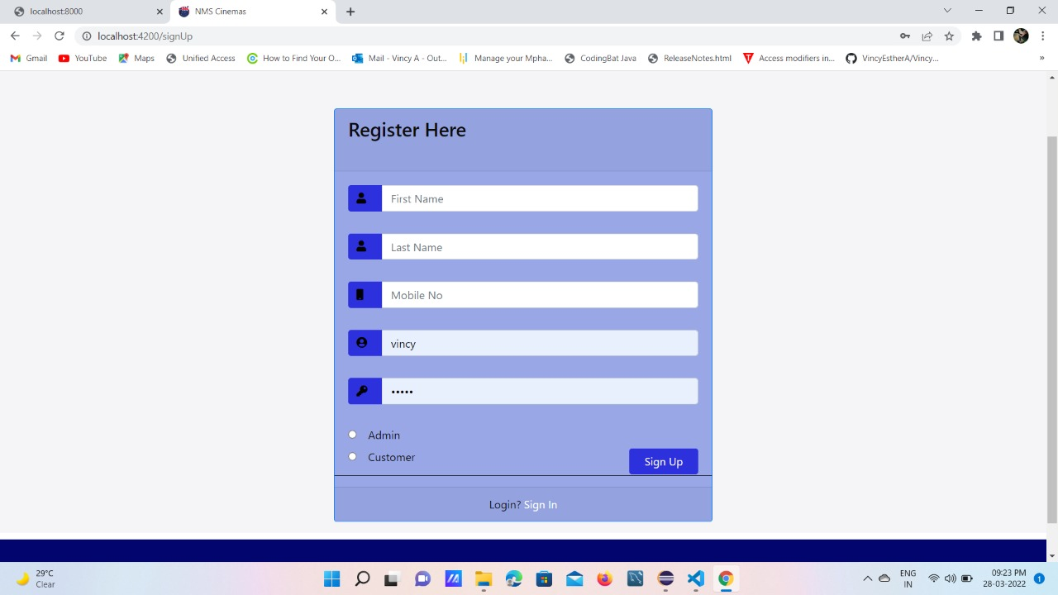

Slide 33
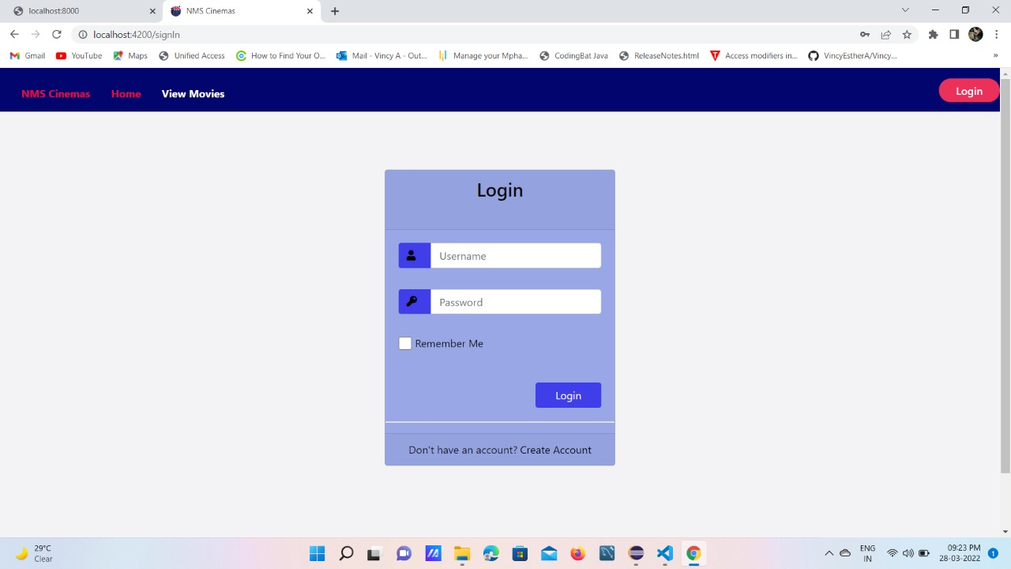

Slide 34
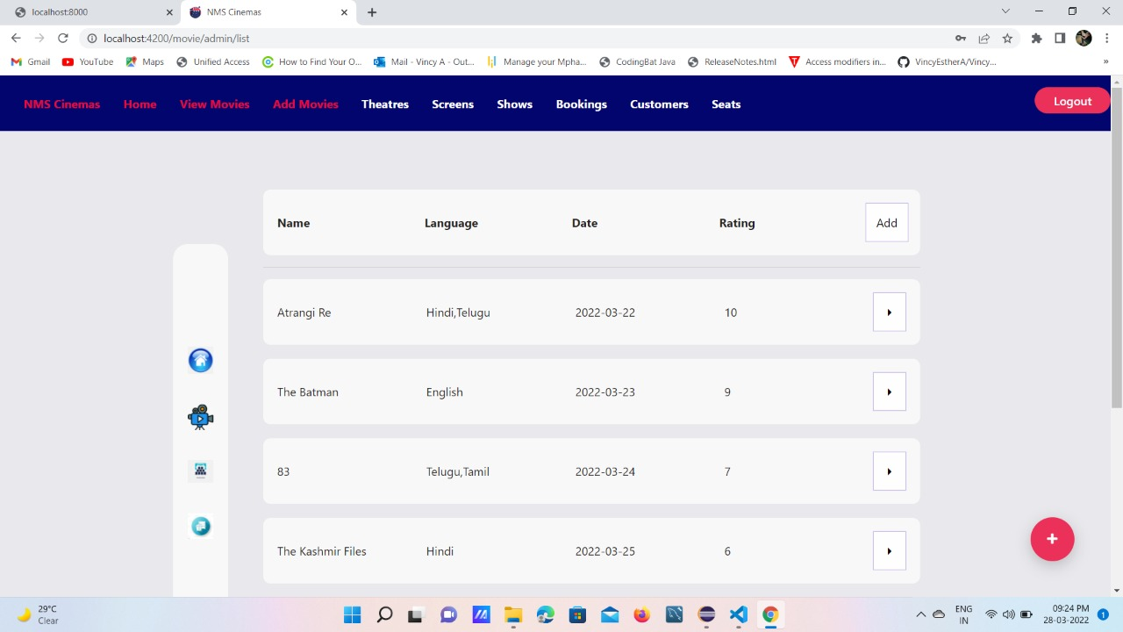

Slide 35
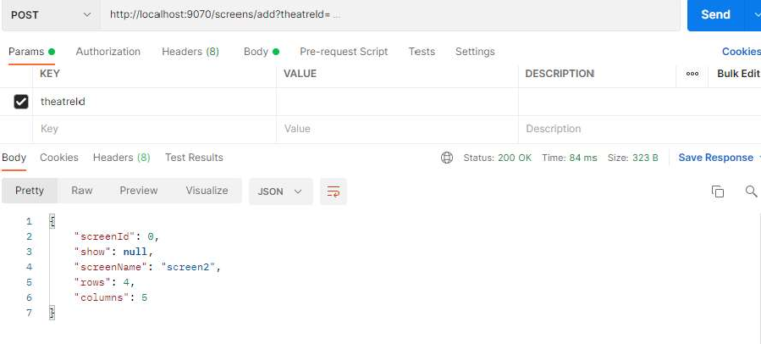

Slide 36
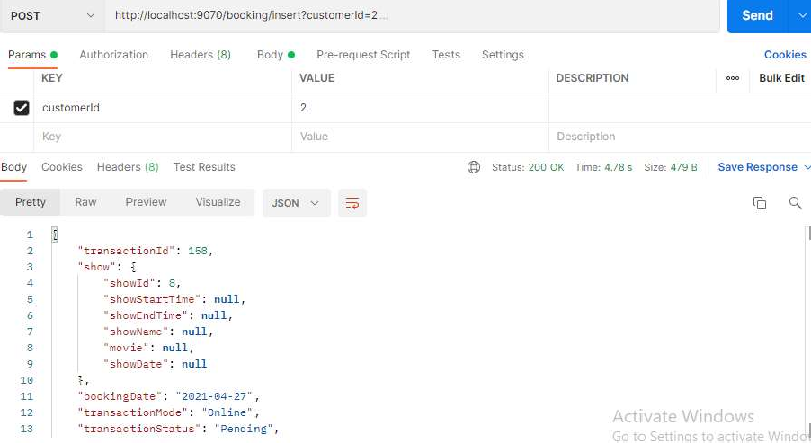

Slide 37
Benefits
To save your time efficiency.
Easy to gather information about movies and theatres.
To provide easy and faster access booking information.
To provide user friendly environment.

Slide 38
FUTURE SCOPE
More features can be added like allowing customer to comment on movies
Provide a list of upcoming movies and searching facilities based on various factors
Secure payment module can be added to the application, for money transaction during ticket booking, using various methods like net banking, UPI, with OPT verification.

Slide 39
CONCLUSION
This project is designed to meet the requirement of a movie ticket booking application
We have designed the project to provide user with easy retrieval of data necessary feedback as much as possible.
This system has been developed with much care and free of errors and at the same time it is efficient and less time consuming
With the software and technological devices, exceptions are reduced and even devices, exceptions prefer easy, quick and safe way for every part of their life.

Slide 40
THANK YOU

